Slide 1
Recommender System Using the Amazon Dataset
By: Thompson Pham

Slide 2
Data Wrangling
The Dataset came from a USCD Professor named Julian McAuley
She provides an entire Amazon dataset as well as various smaller subsets of the data.
The dataset was stored locally and imported into python
.read_json() method
Dropped redundant columns
reviewerID vs reviewerName
reviewTime vs unixReviewTime
Changed data type of some fields
reviewTime from object data type to a DateTime data type
Split up the helpful column
Separate columns for found helpful and total helpful
Changed names of columns
Asin to itemID
Overall to rating

Slide 3
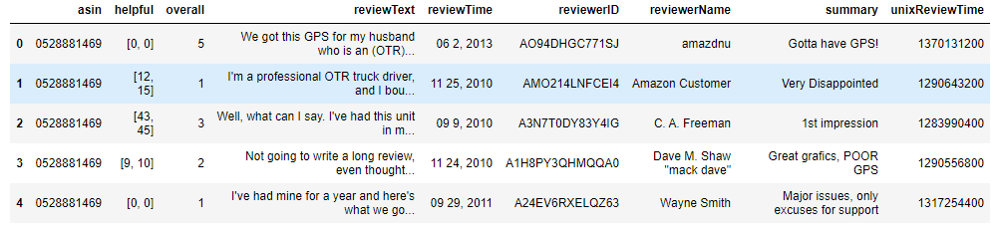
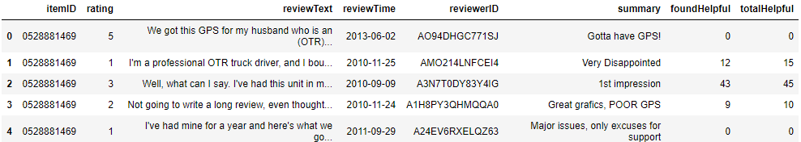
Data Wrangling
Before Cleaning:
After Cleaning:

Slide 4
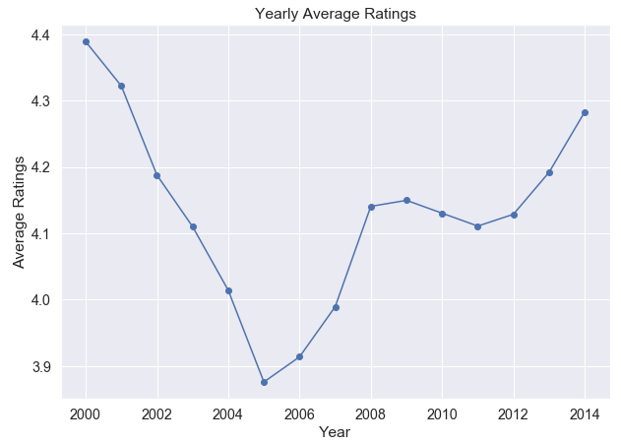
Exploratory Data Analysis
Plot of the average ratings over the years
Very dynamic movement
The lowest rating occurred in 2005 with an average value of about 3.88

Slide 5
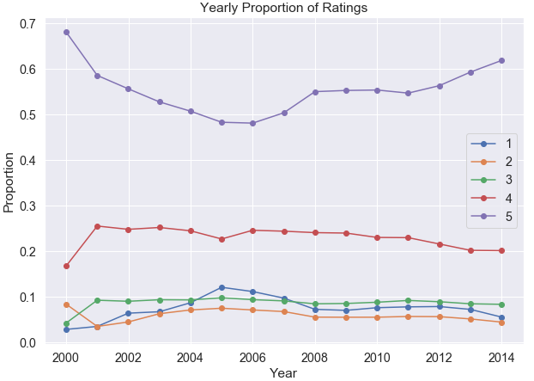
Deeper Analysis
Split the average ratings up into proportion of ratings over the years
The rating of 5 is always the majority proportion
The ratings of 5 and 1 are the most dynamic
The lowest average rating in 2005 can be seen from the lowest proportion for 5 and the highest proportion for 1
Relative to the other ratings, the ratings of 2, 3, and 4 do not change much in proportions over the years

Slide 6
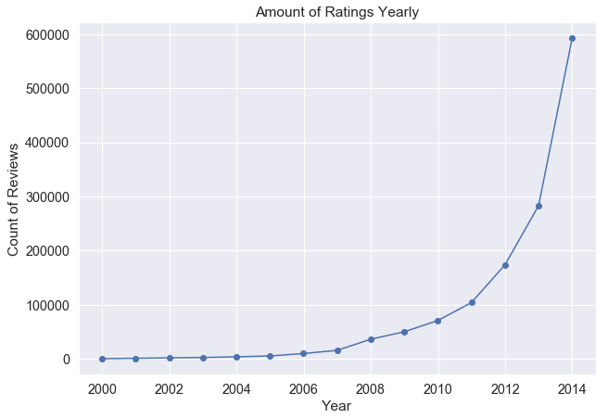
Exploratory Data Analysis
Plot of the count of reviews given over the years
Follows an exponential curve
Would like to make predictions on the plot
Performing a log transformation on the count of reviews will change it into a linear plot
Allows for linear regression to fit a line to the plot

Slide 7
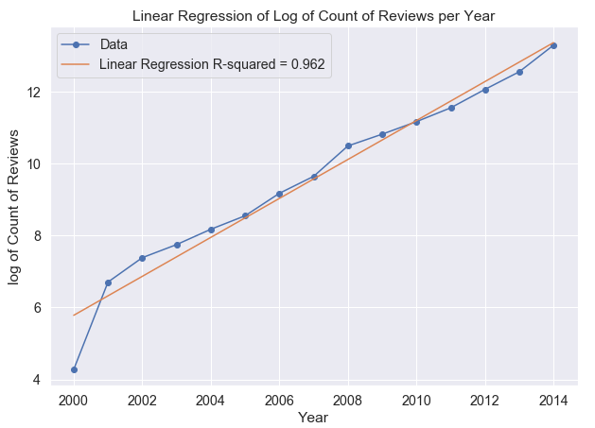
Deeper Analysis
The fitted line had an R-squared value of 0.962
~96% of the variance in the log of Count of Reviews could be explained by the years value
Linear regression line allows for predictions on the growth of the count of reviews over the years

Slide 8
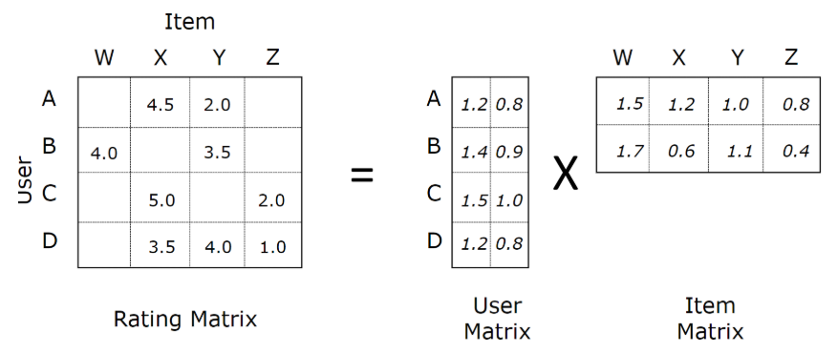
Recommender System
Matrix Factorization
Factorizes a large User x Item matrix into two smaller, separate Users and Items matrix
Performing the dot product on the separate matrices will recreate the original matrix
The separate users and items matrix has latent feature values that can be updated to best predict the ratings based on the original matrix
Can predict user/item pairs of ratings that did not originally exist
https://medium.com/@connectwithghosh/simple-matrix-factorization-example-on-the-movielens-dataset-using-pyspark-9b7e3f567536

Slide 9
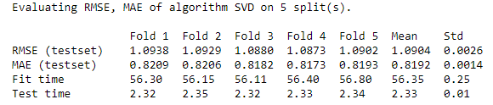
Recommender System
Used the scikit Surprise package to implement the recommender system
The Surprise SVD algorithm closely resembles matrix factorization
Fitted the model on the Amazon dataset
5-fold cross-validation
Results of cross-validation shows model performed equally well on the 5 splits of the dataset

Slide 10
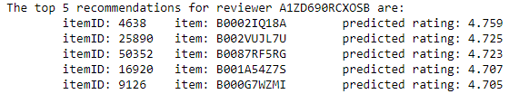
Recommender System
The fitted model allows for predictions of ratings for any reviewer/item pair
For any specific reviewer, all the unrated items can have their ratings predicted
The top 5 items with the highest predicted ratings can be recommended for that specific reviewer

Slide 11
Summary
Saw that the average ratings over the years could be mostly explained by the proportion of ratings that are 5 and 1
The count of reviews over the years followed an exponential curve. Linear regression was performed on the log transformed plot and a fitted line was able to explain about 96% of the variance
Matrix factorization was applied to the Amazon dataset using the scikit Surprise package SVD algorithm.
The model performed equally well on different subsets of the data
For any arbitrary reviewer, the top 5 items with the highest predicted ratings can be recommended

